Slide 1
French and Indian War
Part 5
The Main Event

Slide 2
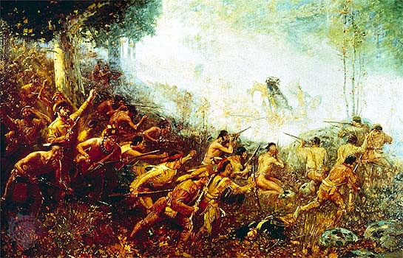
The French, along with their Native American allies, fought the British for control of the North American continent for nine years.

Slide 3
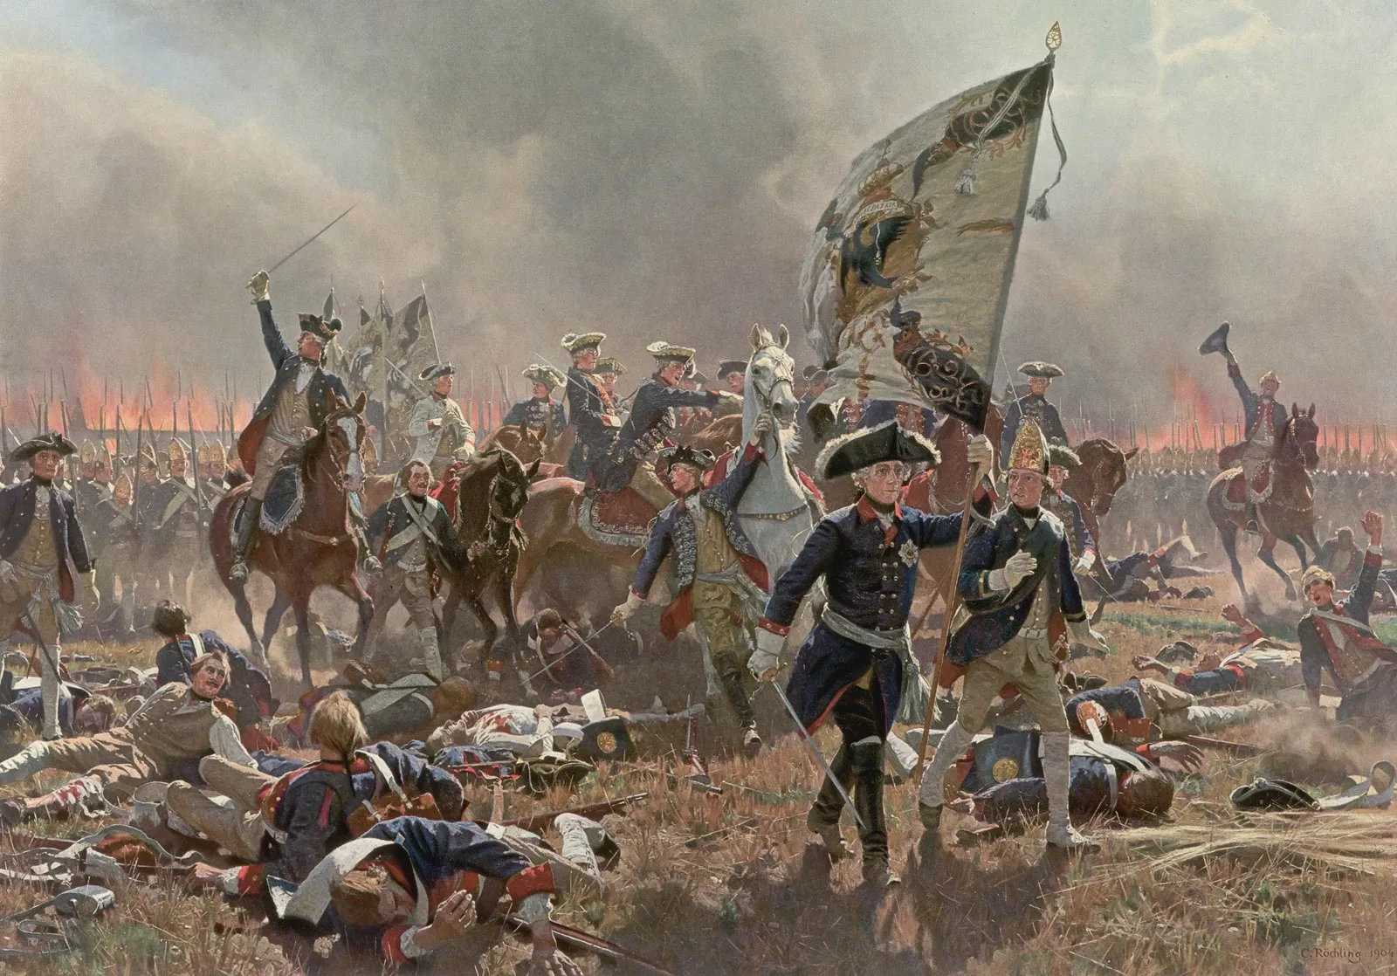
The French and Indian War was once again part of a larger conflict between France and Great Britain called the Seven Years’ War.

Slide 4
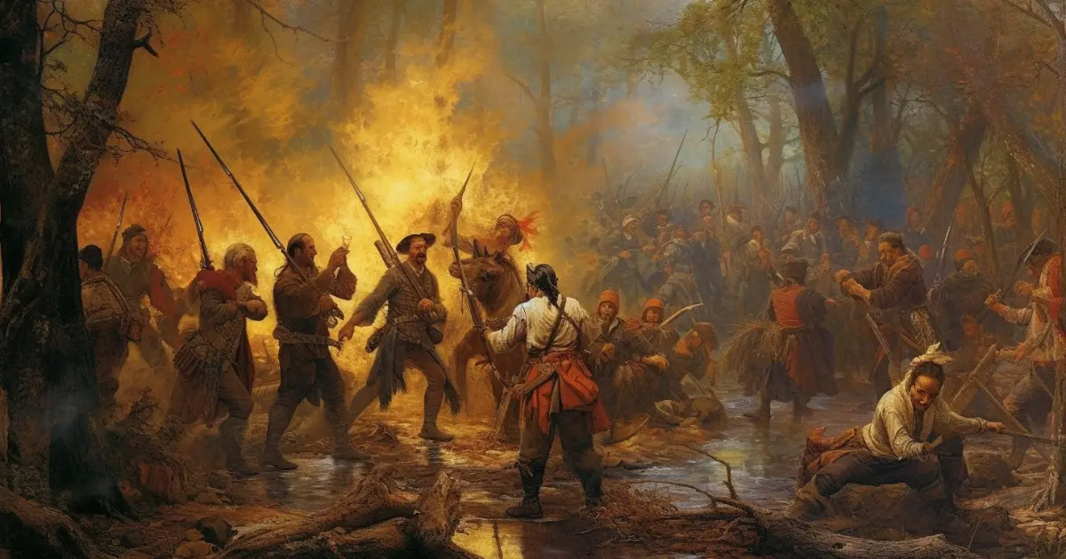
The British didn’t have as much help during the French and Indian War from the Iroquois as they did in the previous wars with the French.

Slide 5
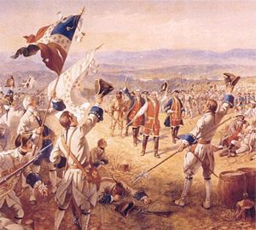
The British lost many early battles in the war to the French.

Slide 6
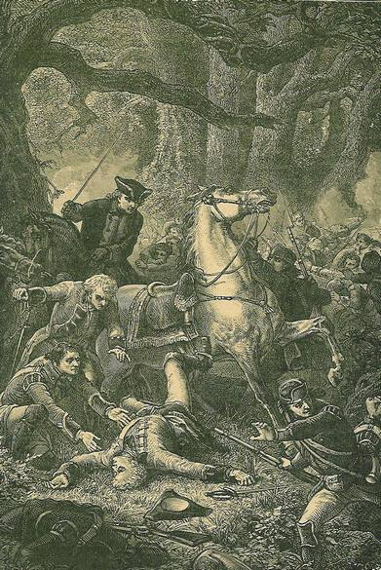
One of those losses was on July 9, 1755, when General Edward Braddock lost the Battle of the Monongahela. Braddock was killed in the fight.

Slide 7
“Quote” and Comment
Write three lines explaining what you think about the story about George Washington during the Battle of the Monongahela.
Share with your partner.

Slide 8
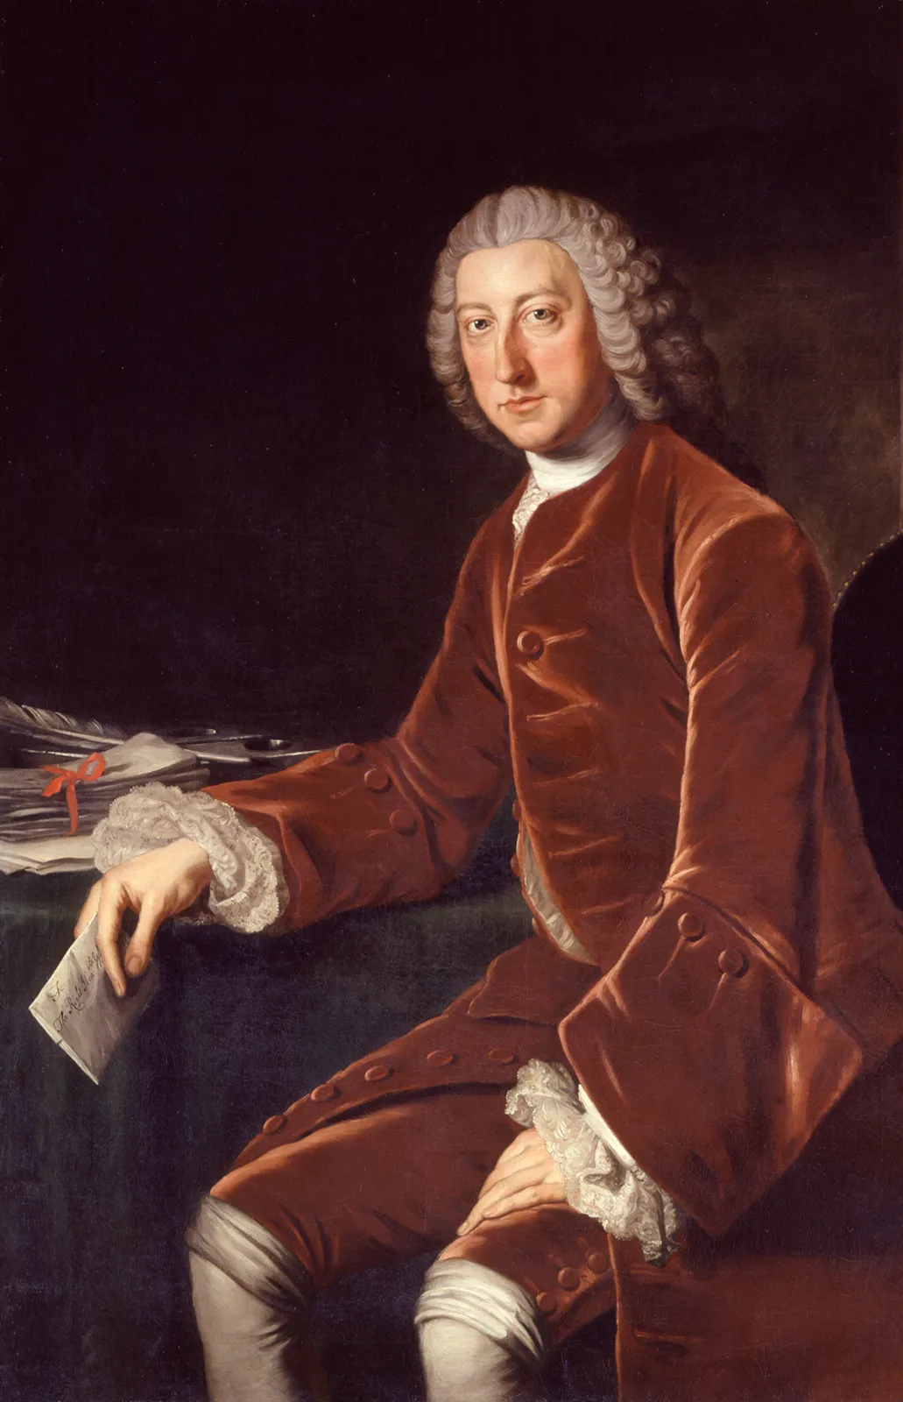
William Pitt became Great Britain’s secretary of state in 1757 and he invested lots of money and materials into the war which helped turn the tide for the British.

Slide 9
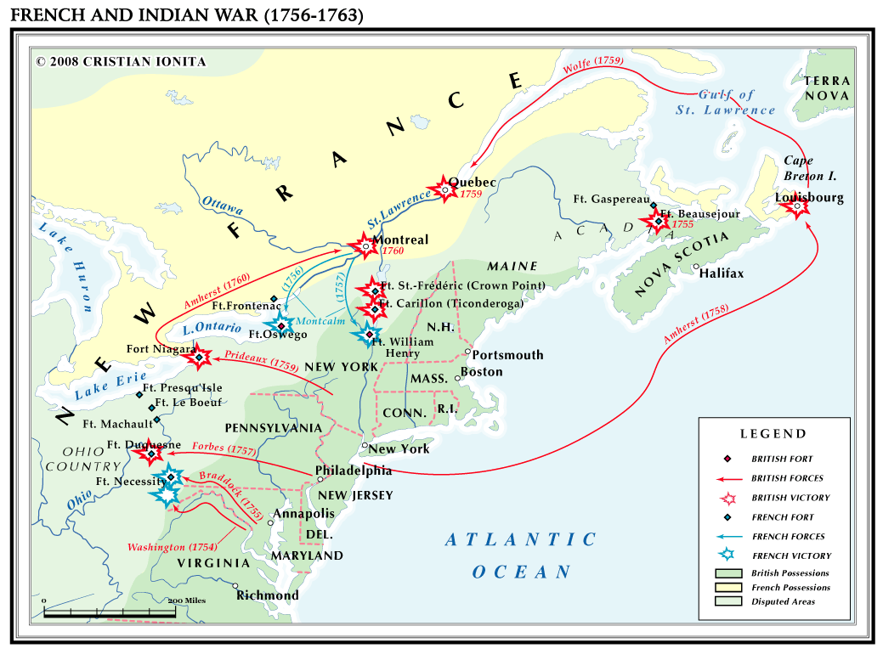
As the war continued, things started going better for the British, and they began to win more battles.

Slide 10
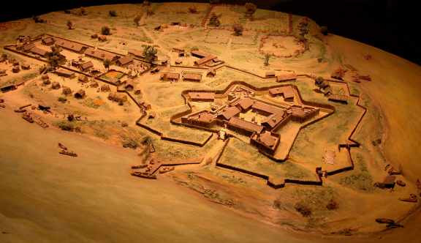
In September of 1758 Fort Duquesne finally fell into British hands. The French burned it down so the British couldn’t use it.

Slide 11
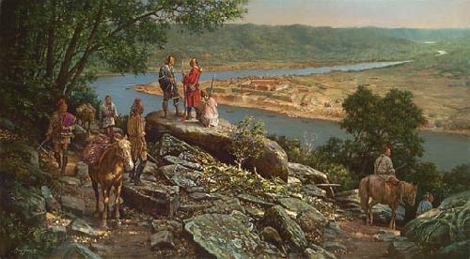
The British built Fort Pitt in place of Fort Duquesne.

Slide 12
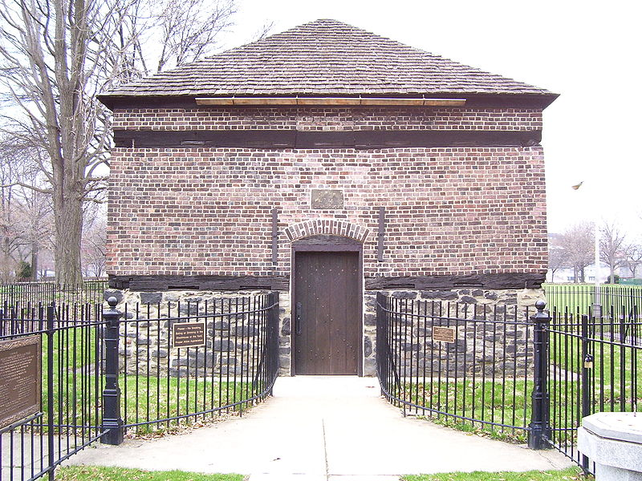
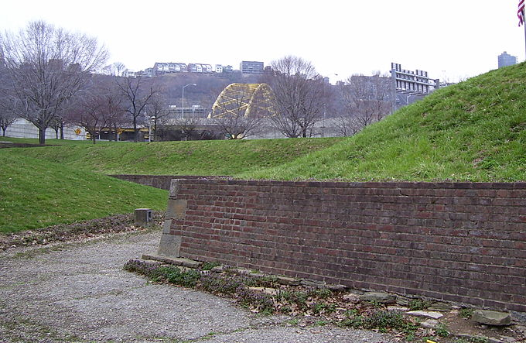
Remains of Fort Pitt today.

Slide 13
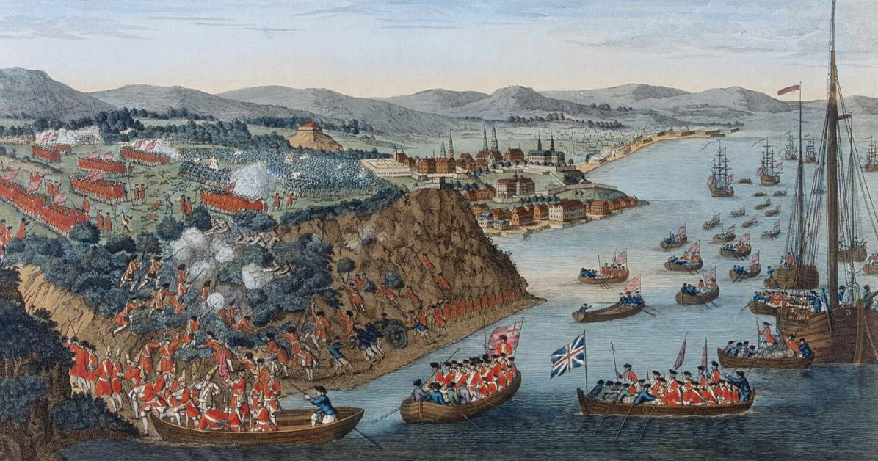
Then in 1759, 200 ships carrying 18,000 British soldiers attacked the stronghold of Quebec and won an important victory!

Slide 14
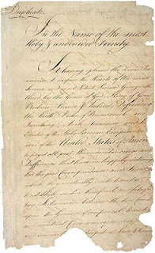
The British finally won the war, and in 1763 the British and French signed the Treaty of Paris.

Slide 15
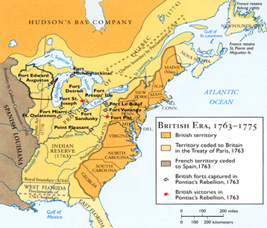
This officially ended the war and gave Great Britain control of North America from the Atlantic Ocean to the Mississippi River.

Slide 16
Also in the negotiations, Great Britain got Florida and Spain got the Louisiana territory.

Slide 17
Exit Question
List one effect of the French and Indian War.

